Slide 1
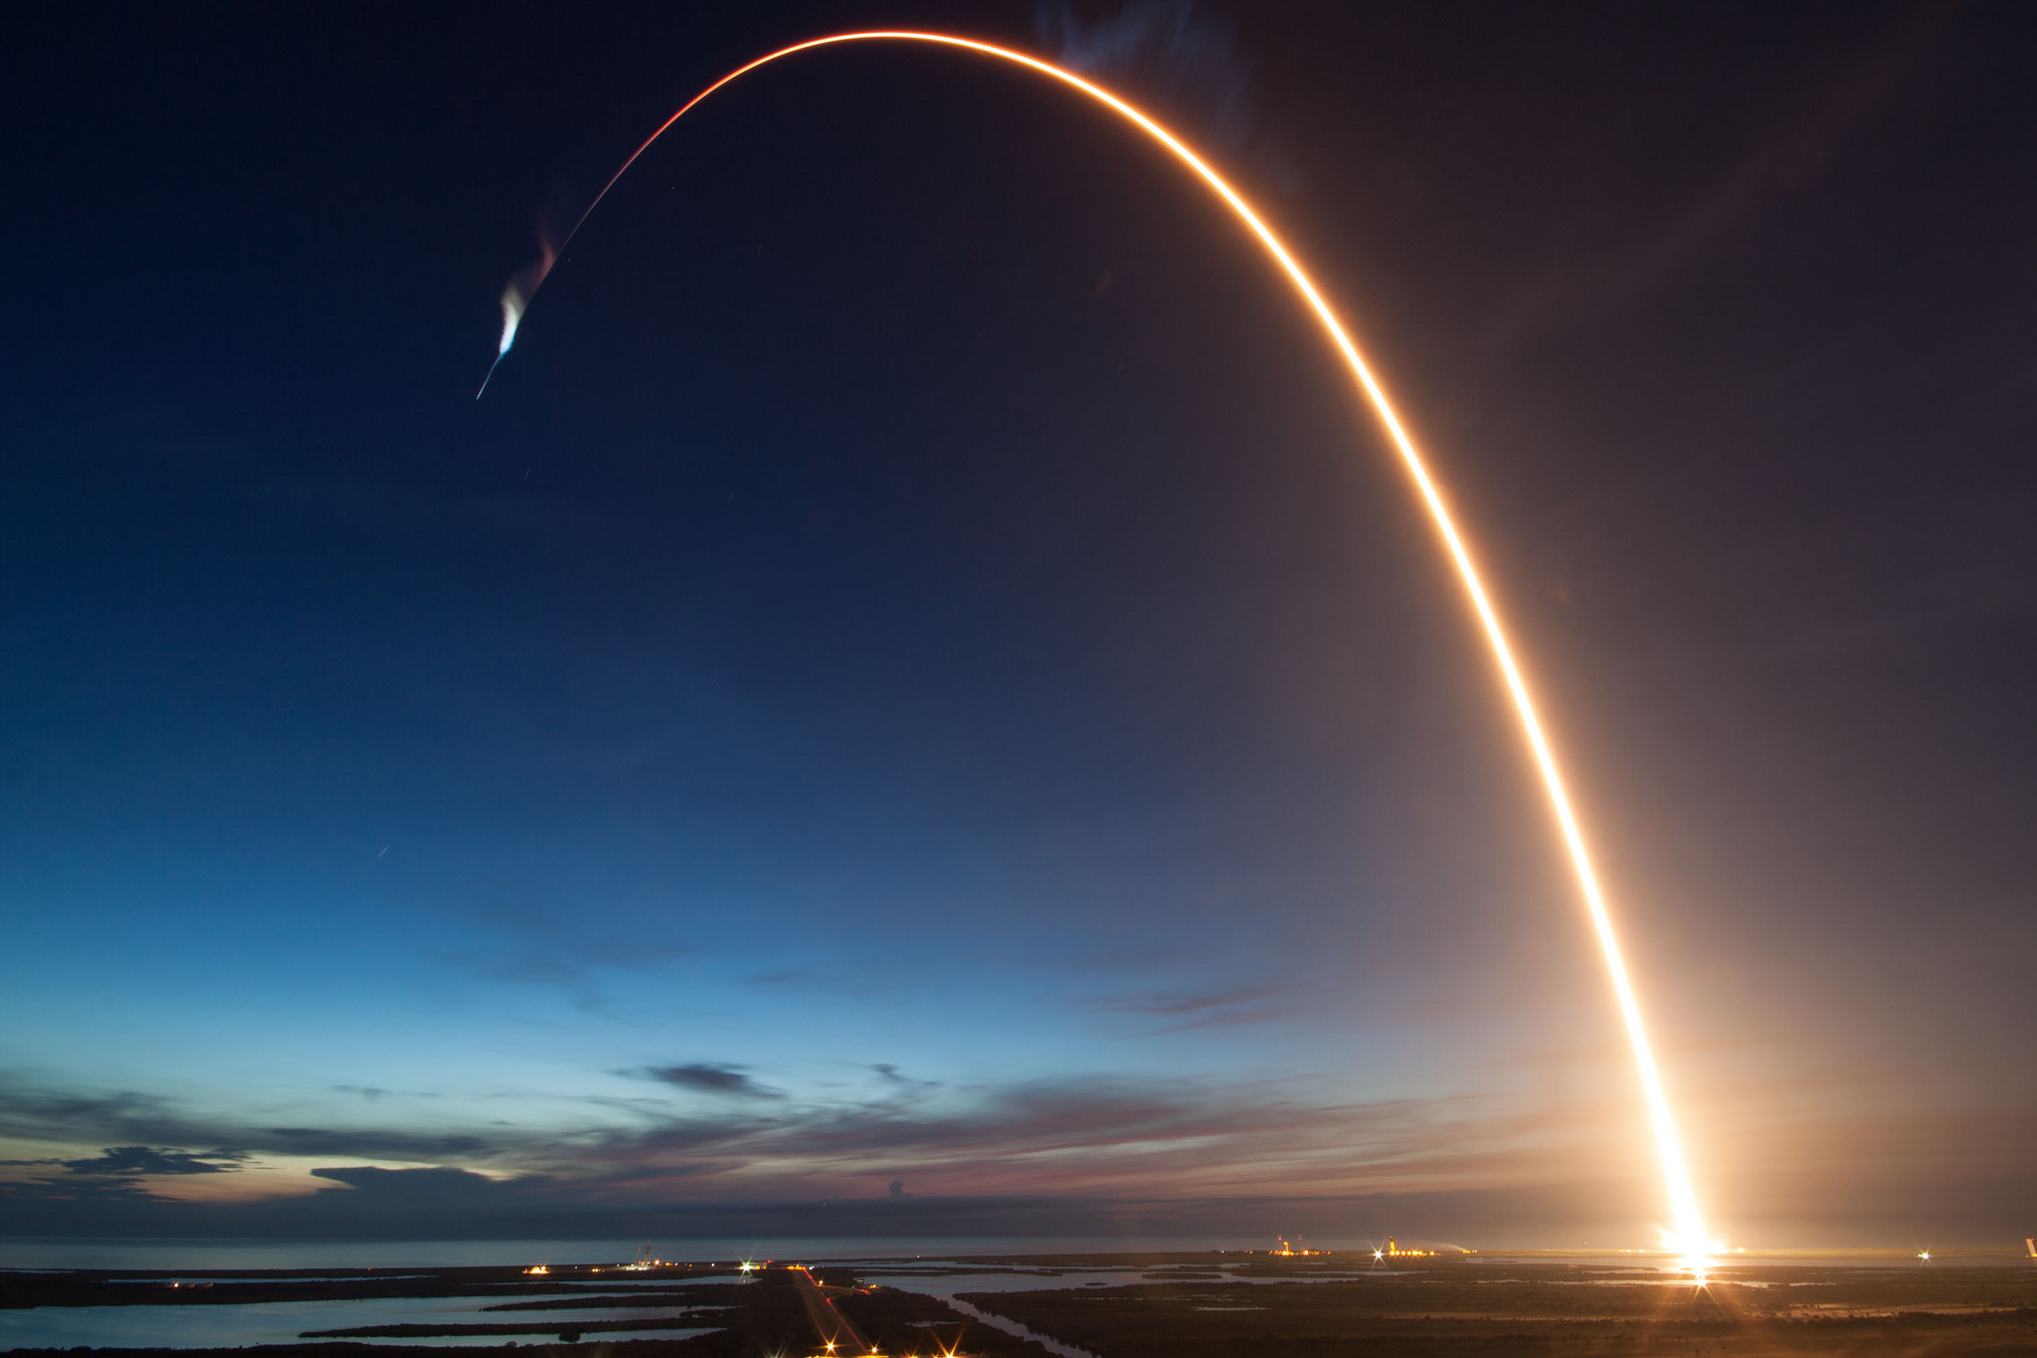
Data Science
Capstone
Project
Name: Collin Bashore
Date: 03/09/2023
https://github.com/collinbashore
Image Source: https://wccftech.com/spacex-believes-amazons-proposed-license-rules-changes-better-for-pre-space-shuttle-era/

Slide 2
Outline
Executive Summary
Introduction
Methodology
Results
Conclusion
Appendix

Slide 3
Executive Summary
Methodology Summary
Data was extracted from the SpaceX Wikipedia page and public SpaceX API. The column ‘Class' was created to categorize true successful landings. Utilized SQL, data visualization, folium maps, and plotly dashboards to explore the data. Compiled important columns for use as features for predictive analysis. Used one hot encoding to convert all categorical variables to binary values and all numeric columns to float64 data type. GridSearchCV was used to determine the ideal parameters for machine learning models using standardized data. Displayed the accuracy rating for each model and confusion matrix for best performing model(s).
Results Summary
Four machine learning models were used for predictive analysis: Logistic Regression, Support Vector Machines, Decision Tree Classifier, and K Nearest Neighbors (KNN). All models (except for KNN – 77.78%) produced similar results around 83.33% accuracy rate. All models over predicted true successful landings and more data will be required for better model determination (dataset used had only 90 records).

Slide 4
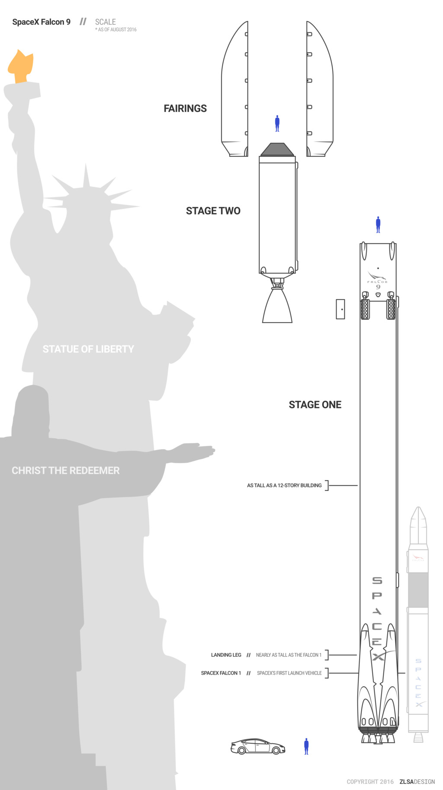
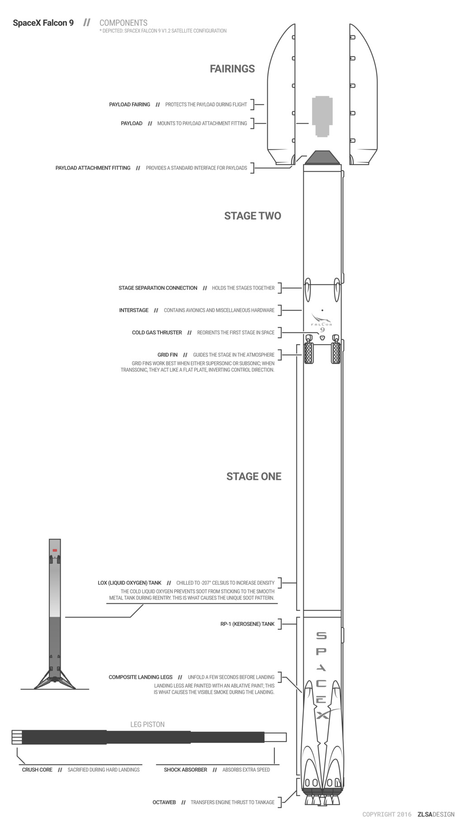
Introduction
Project Background
During the existing commercial space age, companies are making space travel affordable for everyone
Space X conducts most inexpensive launches ($62 million vs. $165 million)
Due to recovery of rocket parts (Stage One)
Space Y wants to compete with Space X
Problem
→ Tasked by Space Y to train a machine learning model to predict successful Stage One recovery
Images sourced from https://zlsadesign.com/

Slide 5
Methodology
Data collection methodology:
Collected and combined data utilizing public Space X API and scraping Space X Wikipedia page
Perform data wrangling
Classified true landings as successful (class=1) and unsuccessful (class=0)
Perform exploratory data analysis (EDA) using visualization and SQL
Perform interactive visual analytics using Folium and Plotly Dash
Perform predictive analysis using classification models
Tuned models using standardized data and finding the best parameters using GridSearchCV

Slide 6
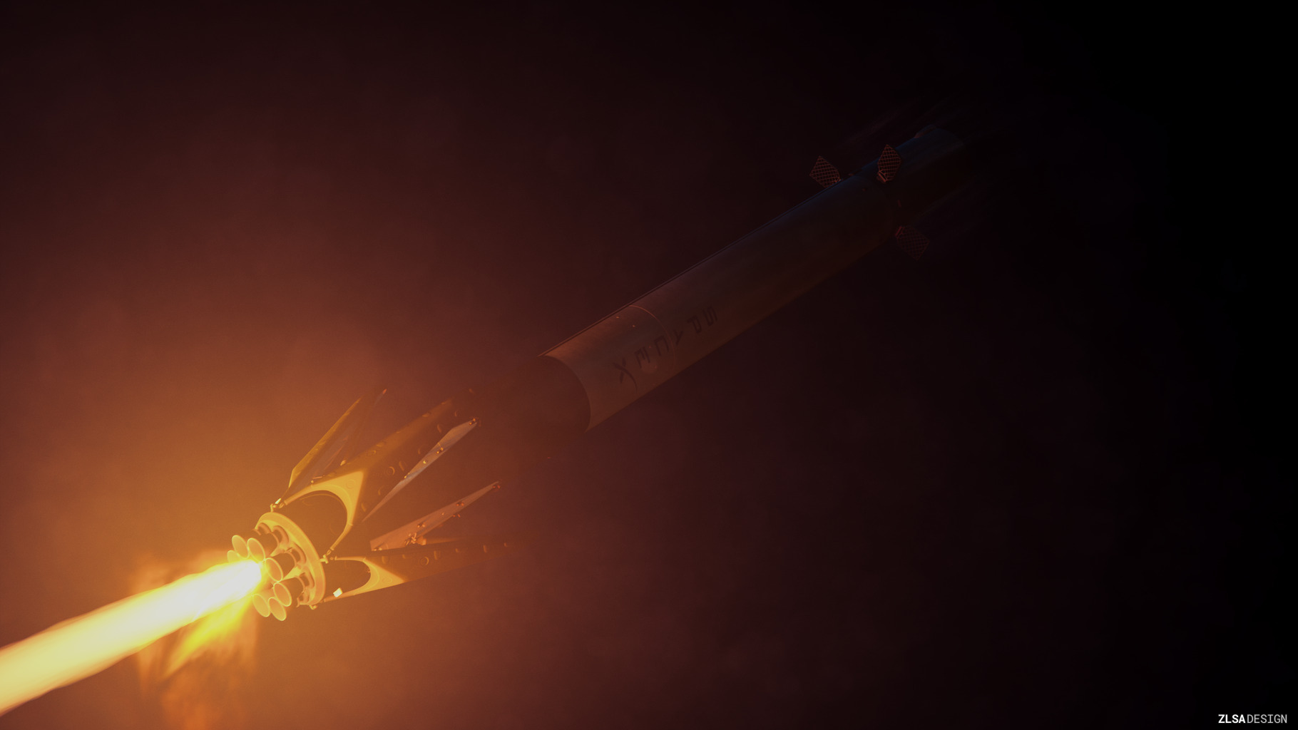
Section 1
Methodology

Slide 7
Data Collection
Data Collection process involved a combination of API requests from Space X public API and webscraping data from a table in SpaceX’s Wikipedia entry
The next two slides shows flowcharts of data collection from public Space X API and data collection from webscraping
Space X Data Columns:
FlightNumber, Date, BoosterVersion, PayloadMass, Orbit, LaunchSite, Outcome, Flights, GridFins,
Reused, Legs, LandingPad, Block, ReusedCount, Serial, Longitude, Latitude
Wikipedia Webscrape Data Columns:
Flight No., Launch site, Payload, PayloadMass, Orbit, Customer, Launch outcome, Version Booster,
Booster landing, Date, Time

Slide 8
Data Collection – SpaceX API
GitHub URL
https://github.com/collinbashore/IBM-Data-Science-Professional-Certification/blob/main/10%20-%20Capstone%20Project/Week%201%20Data%20Cleaning%20-%20Webscraping%20-%20Data%20Wrangling/jupyter-labs-spacex-data-collection-api.ipynb
Request (Space X API)
.JSON file + Lists(Launch site, Booster Version, Payload Data, Cores)
.json_normalize to convert JSON file to DataFrame format
Cast Dictionary format into DataFrame
Combined data columns into dictionary data type
Filter data to only Flacon 9 launches
Impute Payload data with it’s average value

Slide 9
Data Collection – Web Scraping
Request Wikipedia html
BeautifulSoup html5lib parser
GitHub URL
https://github.com/collinbashore/IBM-Data-Science-Professional-Certification/blob/main/10%20-%20Capstone%20Project/Week%201%20Data%20Cleaning%20-%20Webscraping%20-%20Data%20Wrangling/jupyter-labs-webscraping.ipynb
Create dictionary
Find launch info html table
Iterate through table cells to extract data to dictionary
Convert dictionary to DataFrame

Slide 10
Data Wrangling
enumerate all successful and unsuccessful mission outcomes
Value Mapping:
Class = 1
True ASDS, True RTLS, and True Ocean
Class = 0
None None, False ASDS, None ASDS, False Ocean,
False RTLS
GitHub URL
https://github.com/collinbashore/IBM-Data-Science-Professional-Certification/blob/main/10%20-%20Capstone%20Project/Week%201%20Data%20Cleaning%20-%20Webscraping%20-%20Data%20Wrangling/labs-jupyter-spacex-Data%20wrangling.ipynb
Create set of bad outcomes where mission outcome is “False” or “None”
Create training label column ‘Class’ with landing outcomes where landing_class = 0 if bad_outcome and landing_class = 1 if successful outcome

Slide 11
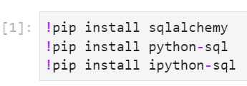
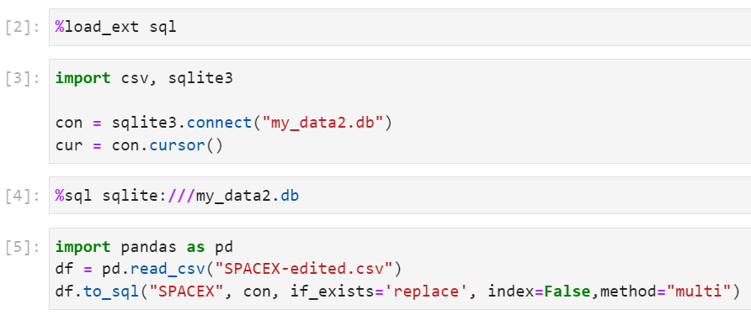
EDA with SQL
- Installed sqlalchemy and python-sql integration
- Connected to sqlite database
SQL Queries Performed
List of Launch Site Names (Task 1)
First five Launch sites beginning with ‘CCA’ (Task 2)
Total and Average Payload Mass for Customers and Booster Versions (Tasks 3 and 4)
Year first successful landing outcome pad was achieved (Task 5)
→ List of Booster Names with successful drone ship and payload mass of 4000 to 6000 kg (Task 6)
Total number of successful and unsuccessful mission outcomes (Task 7)
Booster versions carried max payload mass (Task 8)
Month, Failure Landing Outcomes, Booster Versions, and Launch Site for Drone Ship (Task 9)
Count and rank of successful landing outcomes (Task 10)
GitHub URL
https://github.com/collinbashore/IBM-Data-Science-Professional-Certification/blob/main/10%20-%20Capstone%20Project/Week%202%20Exploratory%20Data%20Analysis/jupyter-labs-eda-sql-coursera_sqllite(1).ipynb

Slide 12
EDA with Data Visualization
Variables used for plots:
→ Flight Number, Payload Mass, Launch Site, Orbit, Class, Year
Plots created:
→ Flight Number vs. Payload Mass
→ Flight Number vs. Launch Site
→ Payload Mass vs. Launch Site
→ Orbit vs. Success Rate
→ Flight Number vs. Orbit
→ Payload vs. Orbit
→ Success Yearly Trend
Plot types
Scatter plots
Line charts
Bar plots
Used to compare relationships between variable to decide if the relationships between each variable exist so that the variables are used for training the machine learning models used for predictive analytics
GitHub URL
https://github.com/collinbashore/IBM-Data-Science-Professional-Certification/blob/main/10%20-%20Capstone%20Project/Week%202%20Exploratory%20Data%20Analysis/jupyter-labs-eda-dataviz.ipynb

Slide 13
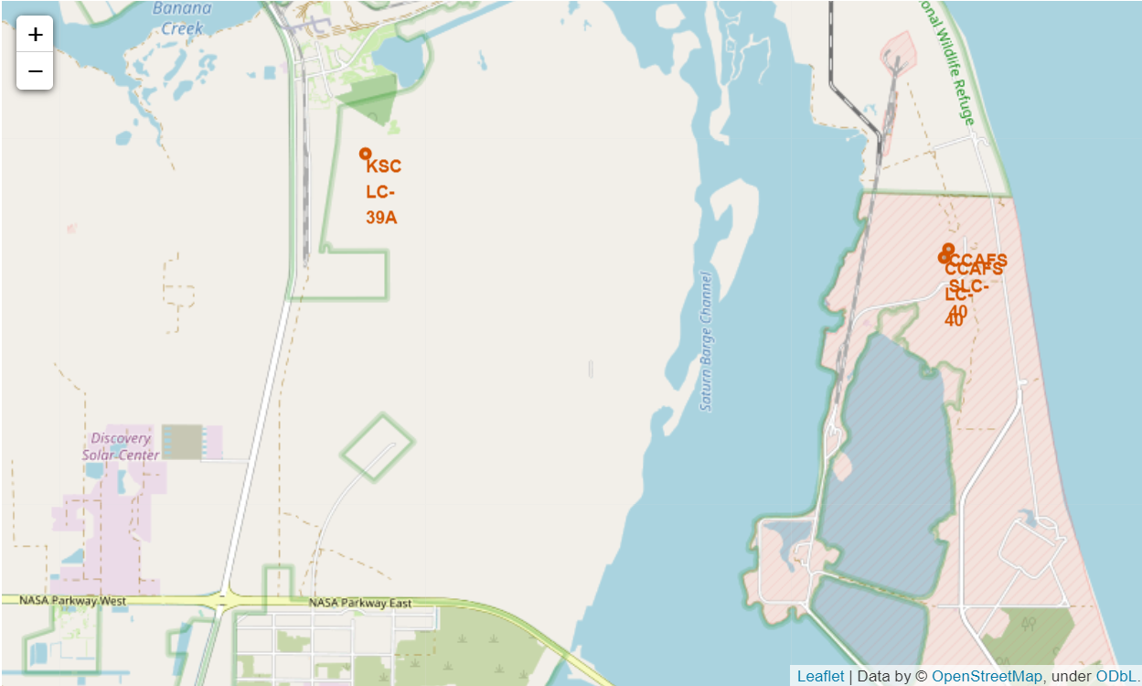
Build an Interactive Map with Folium
- Map objects in Folium such as markers, circles, and lines locates the launch sites, highlights successful and unsuccessful landings, and proximity to the following key locations: Railway, Coastline, City, Highway
- Purpose of having those map objects helps us understand why the launch sites are located in those specific locations and visualizes all successful landings relative to key locations
GitHub URL
https://github.com/collinbashore/IBM-Data-Science-Professional-Certification/blob/main/10%20-%20Capstone%20Project/Week%203%20Visual%20Analytics%20and%20Interactive%20Dashboards/lab_jupyter_launch_site_location.ipynb

Slide 14
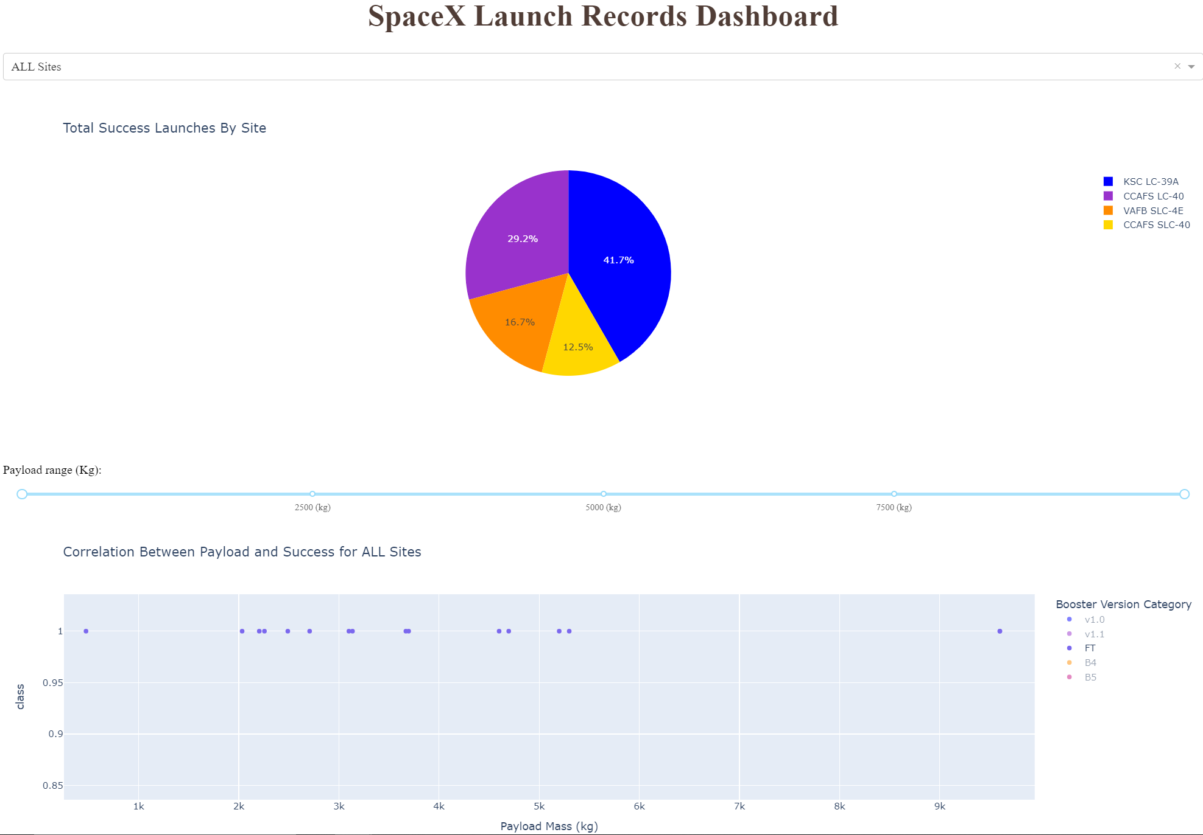
Build a Dashboard with Plotly Dash
- Dashboard includes a pie chart, range slider, and a scatter plot
- Pie chart shows the distribution of successful landings across all launch sites and can be selected to visualize individual launch site success rates
Two inputs: All sites or individual launch sites
- Scatter plot shows how success varies across launch sites, payload mass, and booster version category
Two inputs: All sites or individual sites and payload mass on interactive slider between 0 and 10,000 kg
GitHub URL
https://github.com/collinbashore/IBM-Data-Science-Professional-Certification/blob/main/10%20-%20Capstone%20Project/Week%203%20Visual%20Analytics%20and%20Interactive%20Dashboards/spacex_dash_app.py

Slide 15
Predictive Analysis (Classification)
Split label column ‘Class’ from dataset
Fit and Transform features using StandardScalar()
Train_test_split data
GitHub URL
https://github.com/collinbashore/IBM-Data-Science-Professional-Certification/blob/main/10%20-%20Capstone%20Project/Week%204%20Predictive%20Analytics%20(Classification)/SpaceX_Machine%20Learning%20Prediction_Part_5.ipynb
Plot accuracy scores for all models
Plot confusion matrix for all models
GridSearchCV (cv=10) to find optimal parameters
Score models on test dataset
GridSearchCV on LogReg, SVM, Decision Tree, and KNN models

Slide 16
Results
Exploratory data analysis results
Orbits ES-L1, GEO, HEO, and SSO have the highest average success rates
There are no rockets launched for heavy payload mass (greater than 10,000 kg) for the VAFB-SLC launch site
Interactive analytics demo in screenshots
KSC LC-39A launch site has highest success rate of 41.7%
FT Booster has the most successful landings (13 of 15 with payload mass range of 2,000 to 5,500 kg
Predictive analysis results
Three models: Logistic Regression, Decision Tree, and Support Vector Machines have test accuracy rate of 83.33%
K Nearest Neighbors had test accuracy rate of 77.78%

Slide 17

Section 2
Exploratory Data Analysis

Slide 18
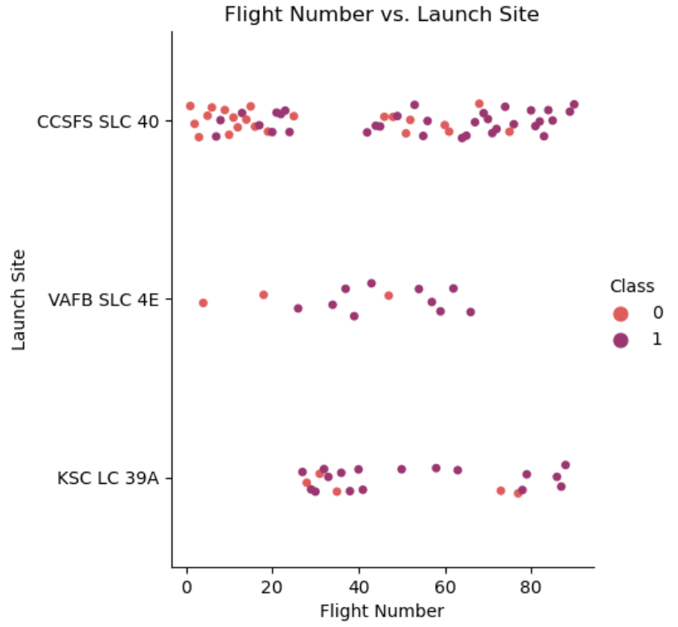
Flight Number vs. Launch Site
Purple indicates successful launches, pink indicates unsuccessful launces
Plot suggests an increase in success rate over time
Possible breakthrough around Flight Number 20 where there’s an increase in successful launces
CCAFS SLC 40 has the most launches and has the most volume of launches

Slide 19
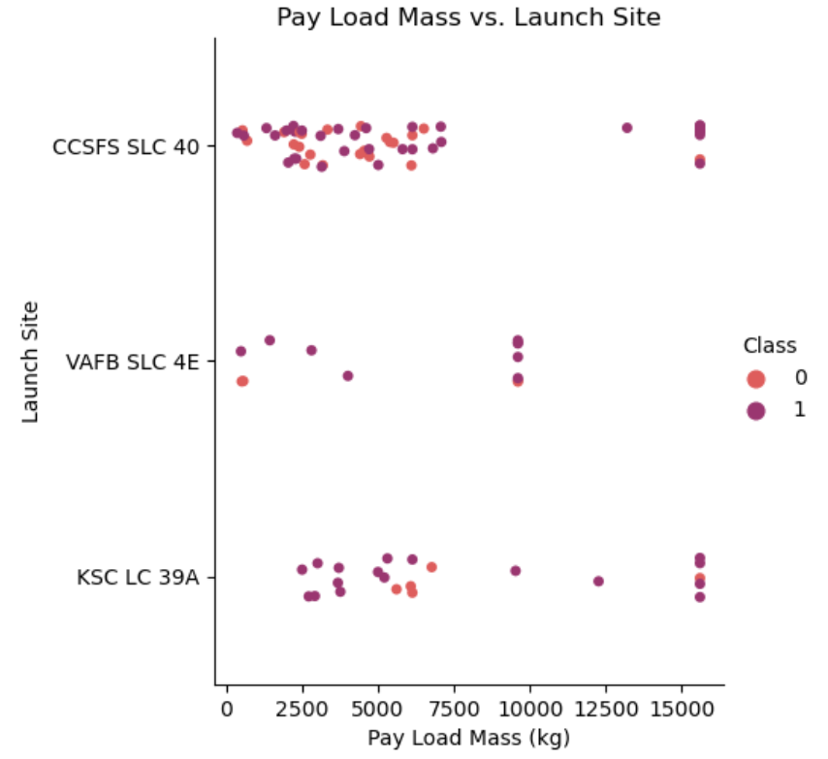
Payload Mass
vs.
Launch Site
Purple indicates successful launches, pink indicates unsuccessful launces
Payload mass mostly appears from 0 to 7,500 kg
Each of the launch sites have different payload masses
VAFB SLC 4E doesn’t have payload masses greater than 10,000 kg

Slide 20
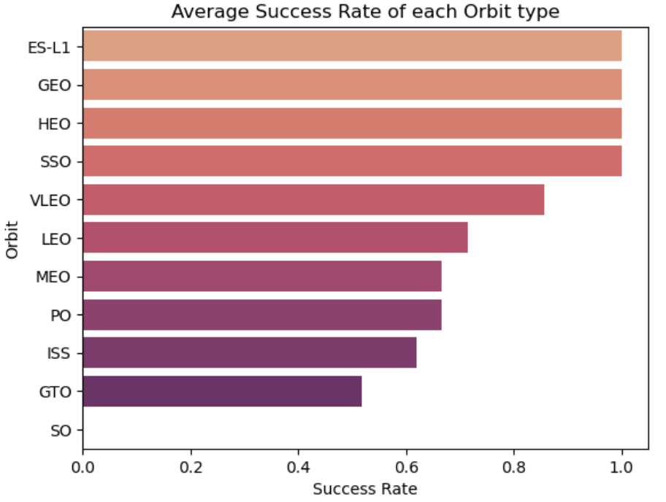
Success Rate
vs.
Orbit Type
ES-L1 (1), GEO (1), HEO(1), and SSO (5) all have success rate of 1.0 (100%).
MEO (3) and PO (9) have success rate of 0.67 (67%)
GTO (27) has success rate of 0.5 (50%)
SO (1) had a success rate of 0 (0%)

Slide 21
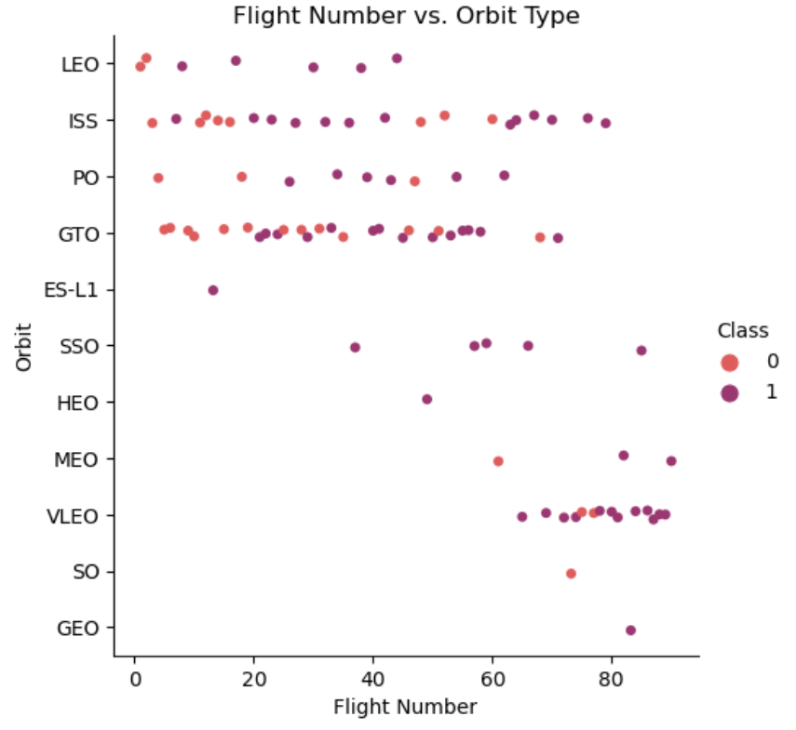
Flight Number
vs.
Orbit Type
Purple indicates successful launches, pink indicates unsuccessful launces
There seems to be more successful launches for Flight numbers greater than 60
Space X appears to have successful launches in lower orbits or Sun-synchronous orbits

Slide 22
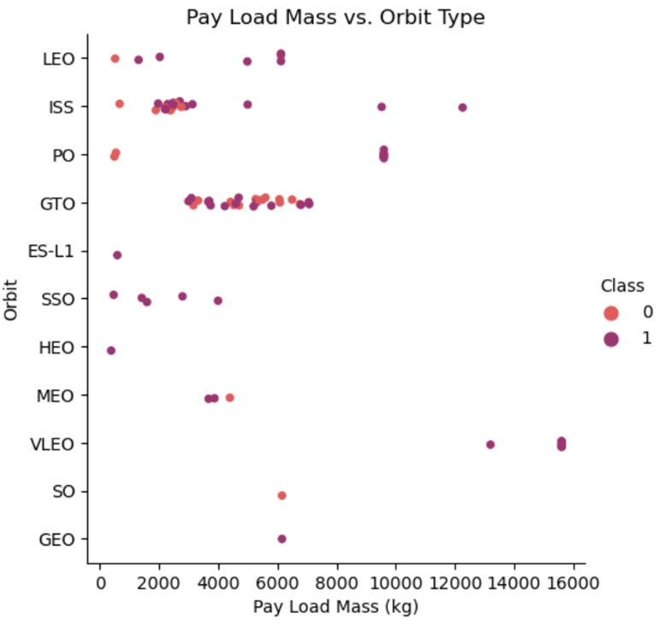
Payload Mass
vs.
Orbit Type
Purple indicates successful launches, pink indicates unsuccessful launces
LEO and SSO appear to have low payload masses
VLEO only has playload masses at the higher range
GTO has a higher concentration of launches with payload masses between 2,500 to 7,500 kg

Slide 23
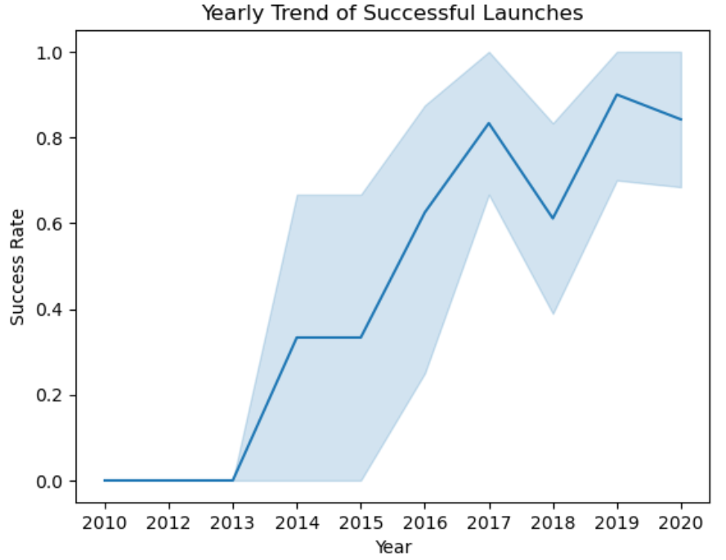
Yearly Trend of Successful Launches
Light blue shading indicates 95% confidence interval
Number of successful launches increases over time starting in year 2013, with slight dip in 2018
Most recent years has success rates around 80%

Slide 24
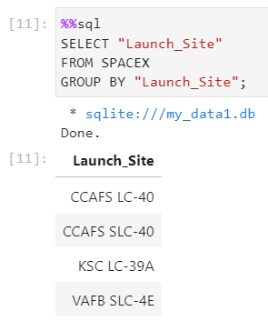
All Launch Site Names
Data entry errors are highly likely for launch sites CCAFS LC-40 and CCAFS SLC-40
Noting the possible data entry error, there’s more than likely only 3 unique launch sites
CCAFS SLC-40, KSC LC-39A, and VAFB SLC-4E

Slide 25
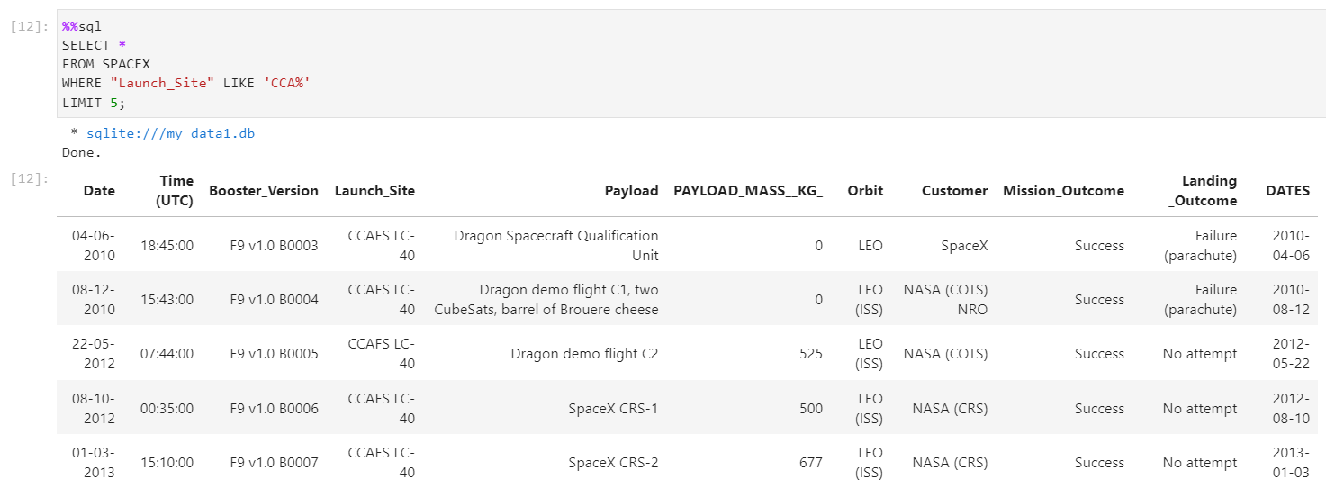
Launch Site Names Begin with 'CCA'
Note on the two date columns:
The original date format in the “
SpaceX.csv” file is in month-day-year
The “DATES” column has a date format year-month-day
Both of those date columns were
used for generating SQL queries
See “Appendix” Section for how the DATES column was created

Slide 26
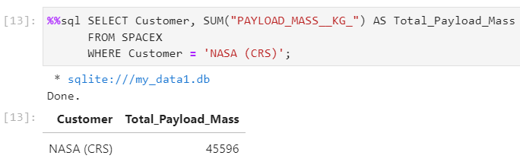
Total Payload Mass
The query below sums all the payload mass (in kg) values where NASA was the customer
CRS strands for Commercial Resupply Services indicating that the payloads were sent to the International Space Station (ISS)

Slide 27
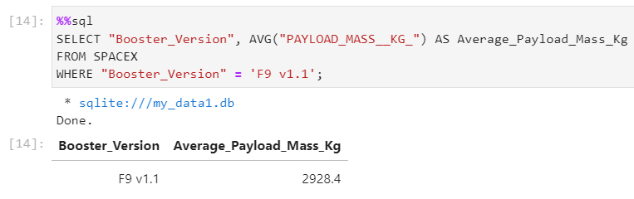
Average Payload Mass by
F9 v1.1
The query to the right calculates the average payload mass carried by booster version F9 v1.1
Average payload mass of F9 v1.1 is on the low end of the payload mass range

Slide 28
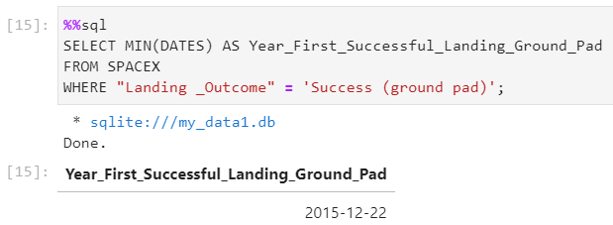
First Successful Ground Landing Date
The query returns the first successful ground pad landing date
First grounding pad launch didn’t appear until the end of 2015
Successful launches didn’t appear until 2014

Slide 29
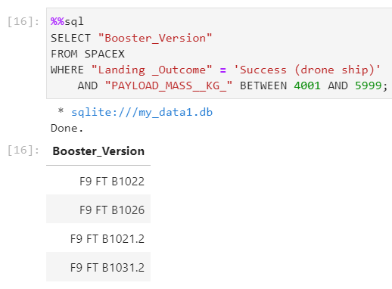
Successful Drone Ship Landing with Payload between 4000 and 6000
This query returns the four booster versions that had successful drone ship landings and a payload mass between 4000 and 6000 kg non-inclusively

Slide 30
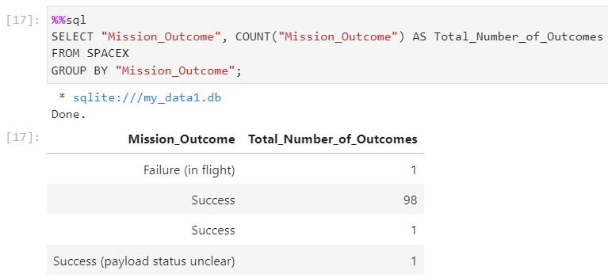
Total Number of Successful and Failure Mission Outcomes
This query calculates the total number of successful and failure mission outcomes
The two “Success” rows could come from a data entry error noted on Slide 24. There should be a total of 99 Success Missions
Only one launch failed in flight and the other launch had an unknown payload status

Slide 31
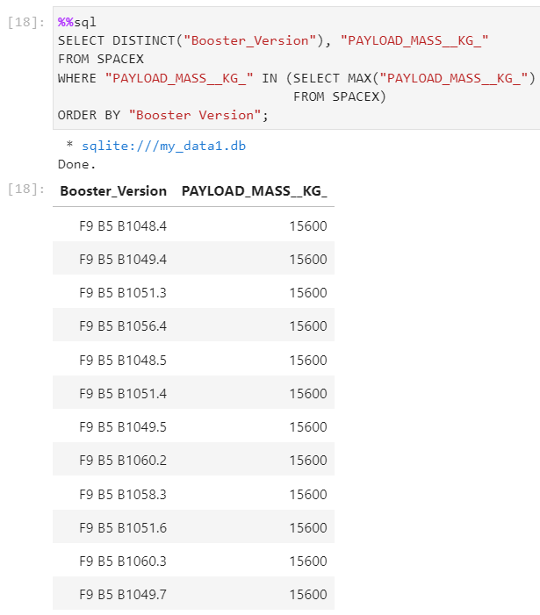
Boosters Carried Maximum
Payload
The query returns the booster versions that carry a maximum payload mass of 15,600 kg
All boosters fall in the “F9 B5 B10xx.x” variety
There appears that the payload mass correlates with the booster version used.

Slide 32
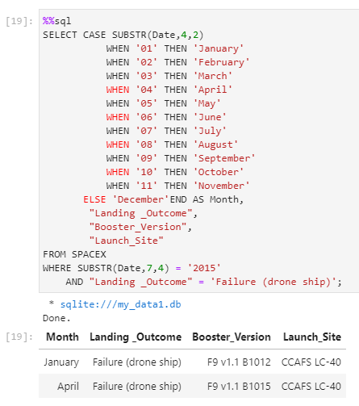
Note: SQLite does not support monthnames function. So SUBSTR(Date, 4, 2) as month to get the months and SUBSTR(Date,7,4)='2015' for year.
2015 Launch Records
This query returns the Month number, landing outcome, booster version, and launch site for the 2015 launches where Stage One failed to land on a drone ship
Two of those occurrences were at the same launch site

Slide 33
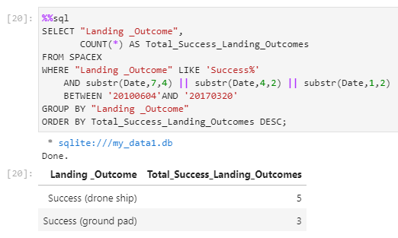
Rank Landing Outcomes Between
2010-06-04 and
2017-03-20
The query returns a list of successful landings between 2010-06-04 and 2017-03-20
Two types of successful landing outcomes
Ground pad
Drone ship
There are a total of 8 successful landings during that time period

Slide 34
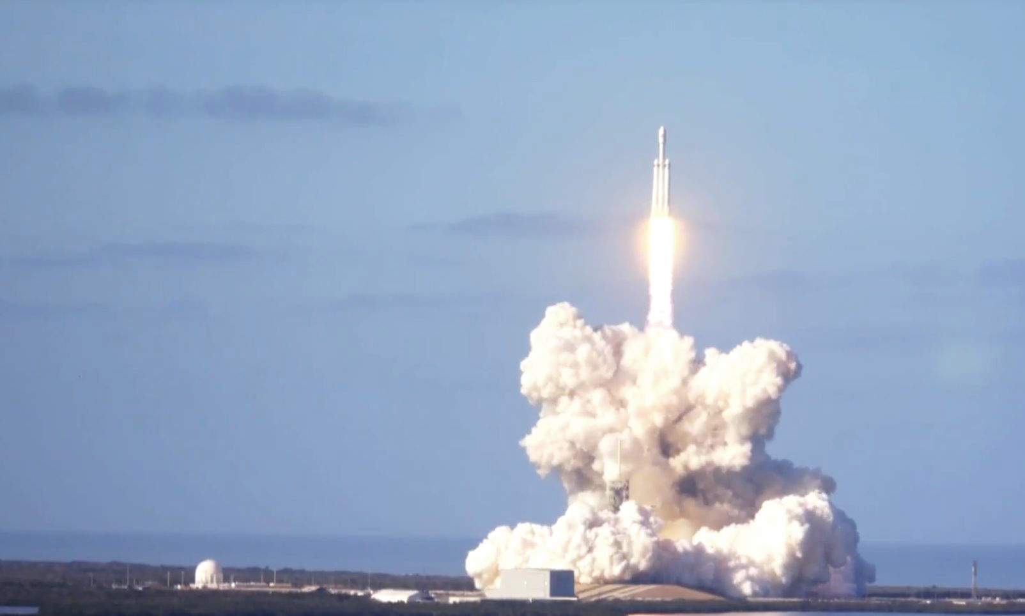
Source: https://www.eclipseaviation.com/spacex-a-history-of-launch-failures-and-successes/
Section 3
Interactive Map with Folium

Slide 35
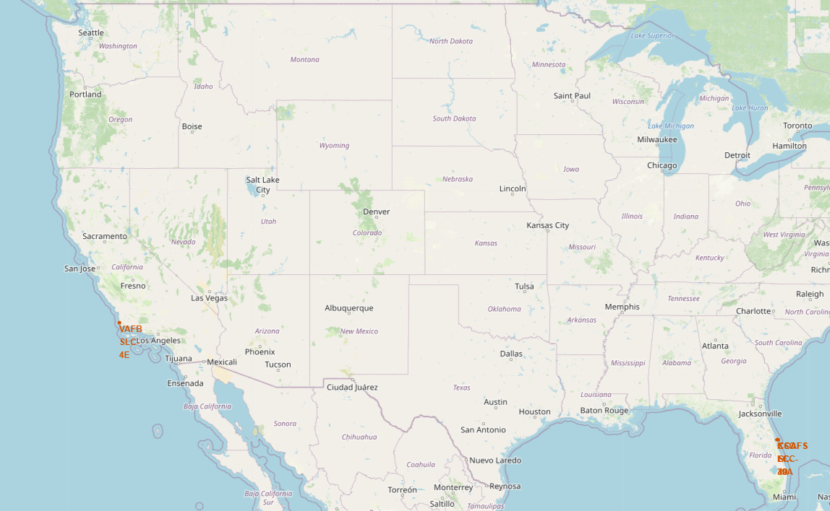
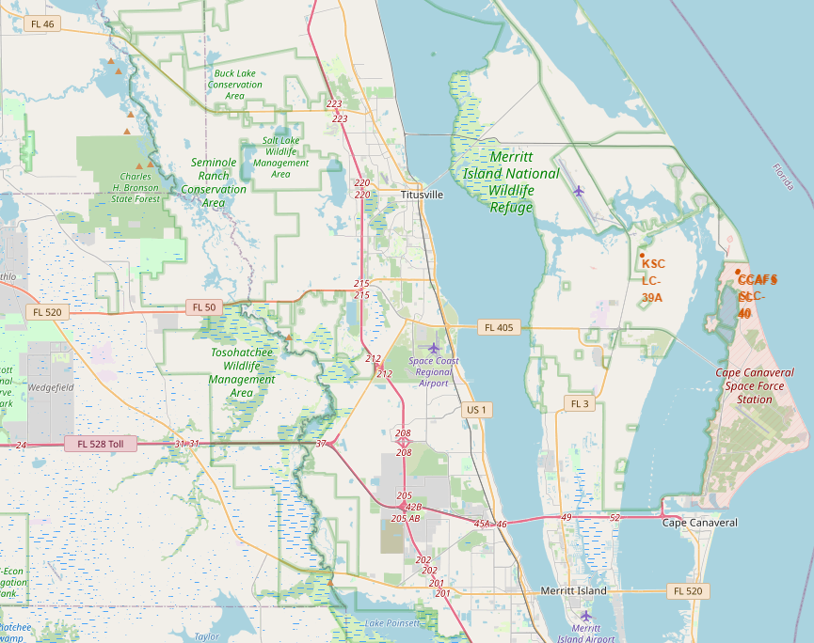
Launch Site Locations
Image on the left shows all the launch site locations on the U.S. map. The image on the right shows the two launch site locations
in Florida. All of the launch sites are near the ocean and far from cities.

Slide 36
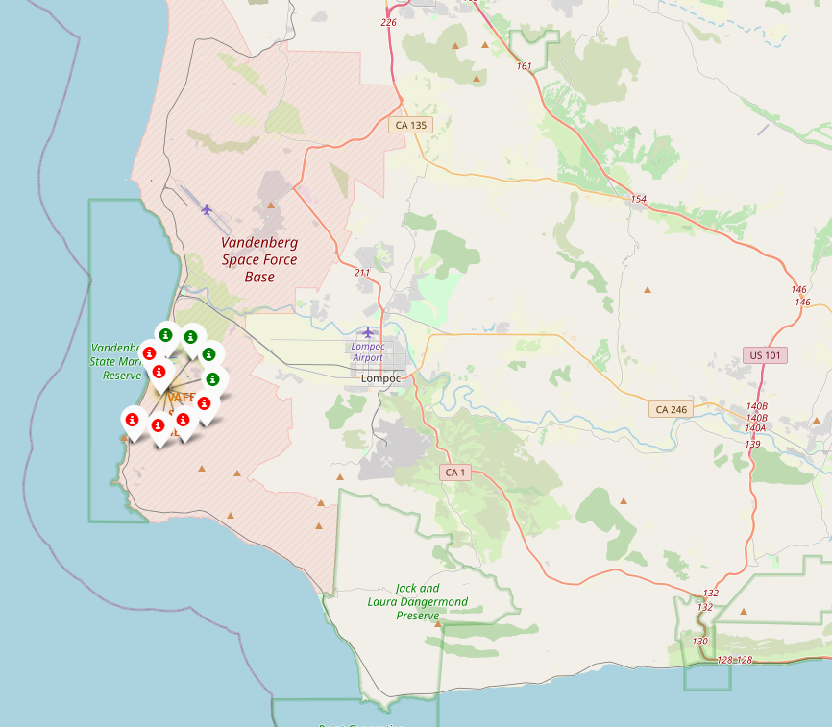
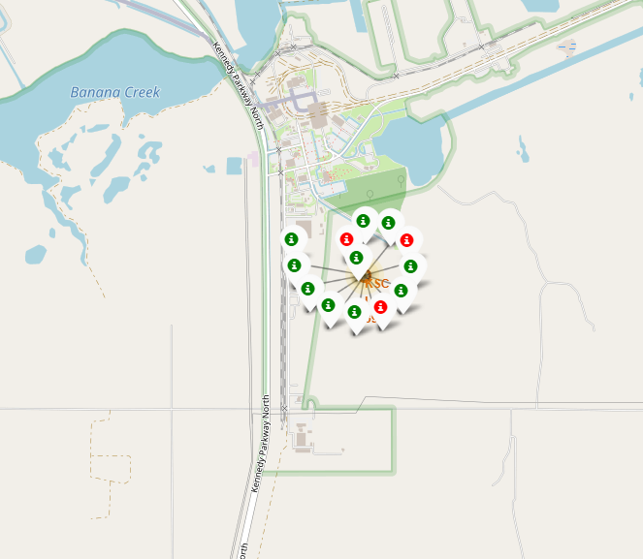
Color-Coded Launch Markers
Marker clusters on Folium map are clickable and are displayed as successful landing (green icon) and failed landing (red icon). Image on the left (VAFB-SLC-4E) shows 4 successful and 6 failed landings while image on right (KSC-LC-39A) shows 10 successful and 3 unsuccessful landings.

Slide 37
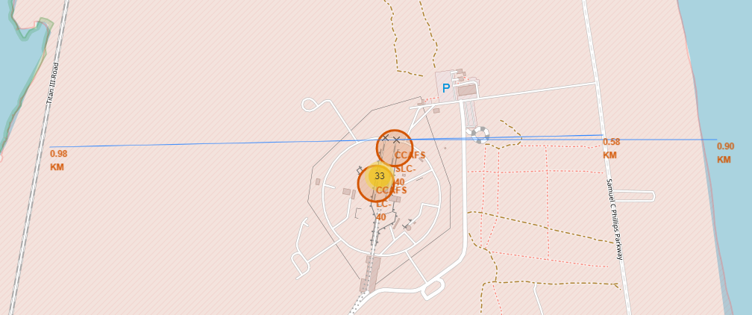
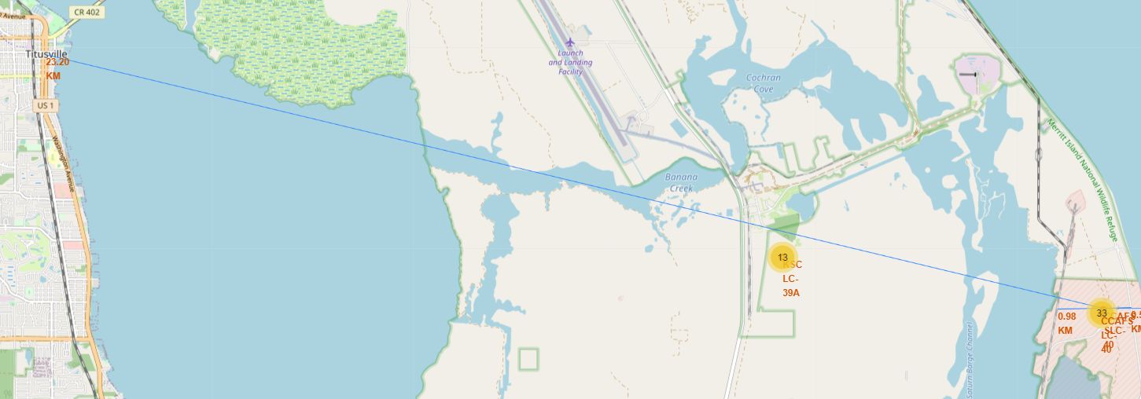
Key Location Proximities
Image on the top shows the distances from CCFAS-SLC-40 launch site to the following key locations: Highway, Railway, and Coastline
Distance to nearest coastline: 0.90 km
Distance to nearest railway: 0.98 km
Distance to nearest highway: 0.58 km
Bottom image shows distance from CCFAS-SLC-40 launch site to nearest city of Titusville, FL (23.20 km).
Launch sites are far from cities so that failed launches can land into ocean avoiding rocket parts falling on densely populated areas.

Slide 38
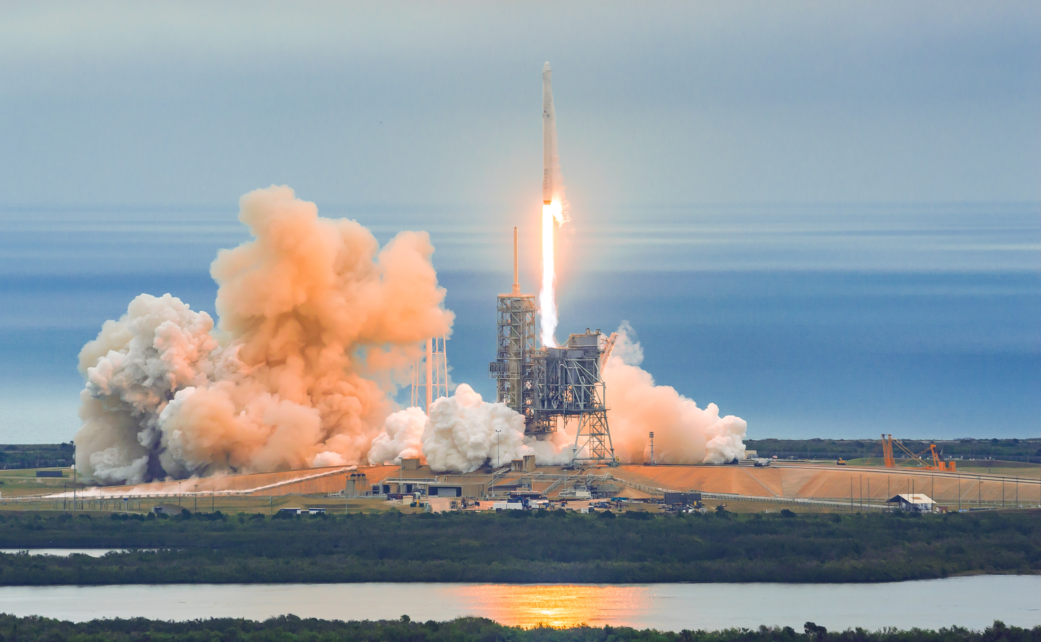
Section 4
Build a Dashboard with Plotly Dash
Source: https://www.eclipseaviation.com/spacex-a-history-of-launch-failures-and-successes/

Slide 39
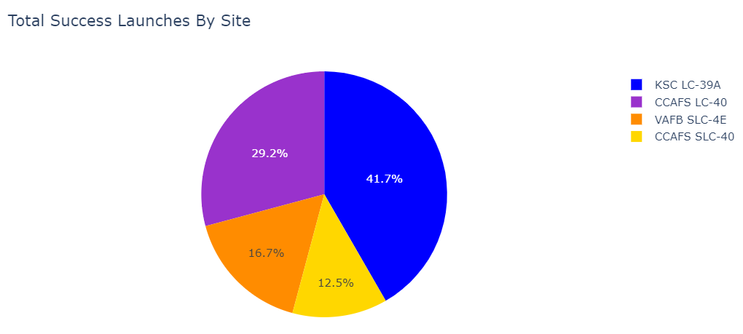
Successful Landings Across Launch Sites
Above is the distribution of successful landings across launch sites. Since CCAFS LC-40 is the older name for CCAFS SLC-40, the number of successful landings for CCAFS SLC-40 (total of 41.7%) and KSC LC-39A (41.7%) have roughly the same amount of successful landings. VAFB SLC-4E has the smallest area of successful landings of 16.7%. This small amount of successful landings in the west coast may be due to smaller sample size and difficulty of launching rockets.

Slide 40
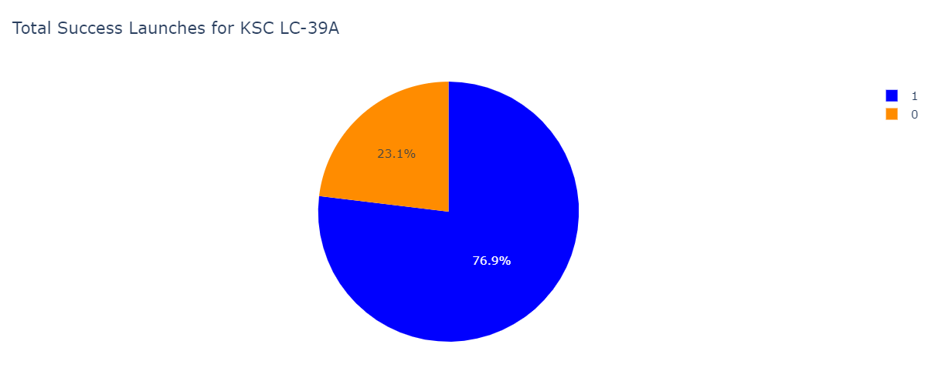
Launch Site with Highest Success Rate
KSC SLC-39A has the highest success rate with 76.9% successful landings and 23.1& failed landings.

Slide 41
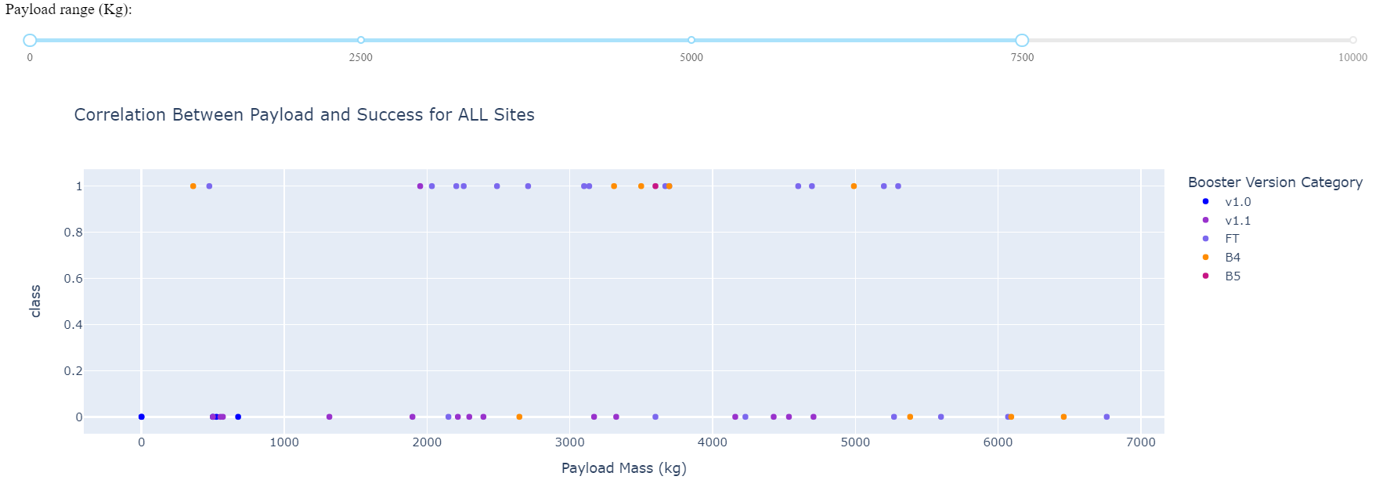
Payload vs. Launch Outcome
The Payload range selector is only set from 0 to 10,000 kg, not including payloads greater than 10,000 kg. class 1 indicates successful landing and 0 for failure. The FT booster version accounts for majority of successful landings within the range 0-7,500 kg. The v1.1 booster version accounts for majority of failed landings within the range highlighted below.

Slide 42
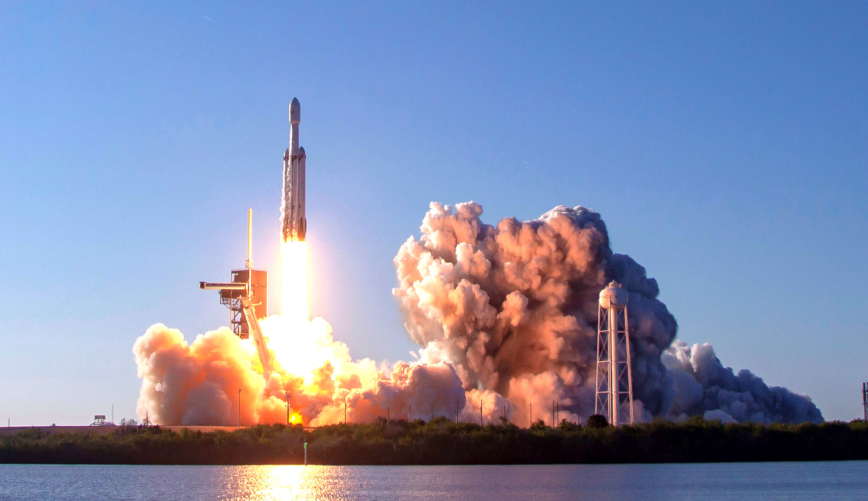
Source: space.com
Section 5
Predictive Analytics (Classification)

Slide 43
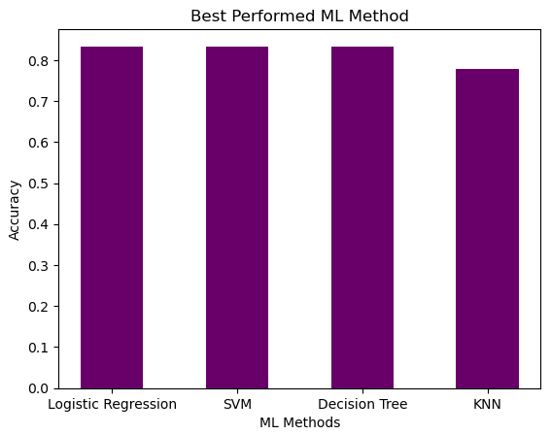
Classification Accuracy
All (except for KNN) have relatively the same accuracy on the test set of 83.33%
KNN’s test accuracy: 77.78%
Test size only has 18 samples, which can cause large variance in accuracy result
More data is more likely needed to determine the most accurate model

Slide 44
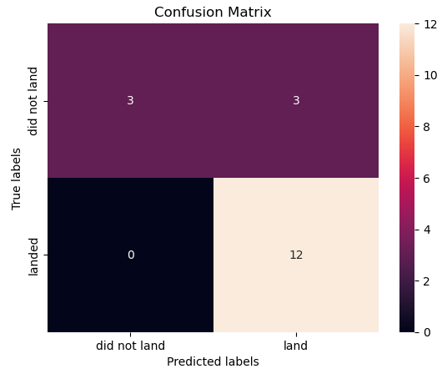
Confusion Matrix
This confusion matrix is the same across for Logistic Regression and Support Vector Machines since the same test set is used to evaluate those models
All correct predictions are on the diagonal of the matrix starting from top left to bottom right.
The models predicted 12 successful landings when the true label = landed
The models predicted 3 unsuccessful landings when the true label = did not land
The models predicted 3 successful landings when the true label = did not land
Successful landings were over predicted

Slide 45
Conclusions
Task: Develop a machine learning model for Space Y who wants to bid against Space X
A machine model was created with an accuracy of 83.33%
The goal of the model is to predict when Stage One will successfully land to save ~$100 million USD
Space Y can implement this model to predict whether a launch will have successful Stage One landing before determining whether a launch should be made or not
Suggestion: Collect more data , if possible, to better determine the best machine learning model and improve model accuracy

Slide 46
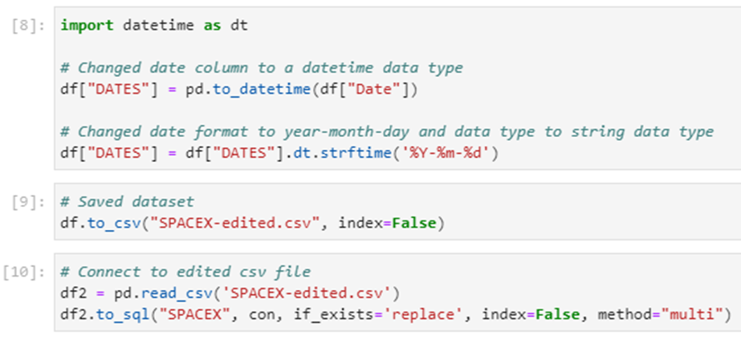
Appendix
Python code for creating a “DATES” column for Section 2
GitHub repository:
https://github.com/collinbashore/IBM-Data-Science-Professional-Certification

